Slide 1
Pluggable Scanner
2019/10/09
Steven Zou

Slide 2
Scanning Workgroup
https://github.com/goharbor/community/blob/master/workgroups/wg-scanning/README.md

Slide 3
Architecture Overview
https://github.com/goharbor/community/pull/98

Slide 4
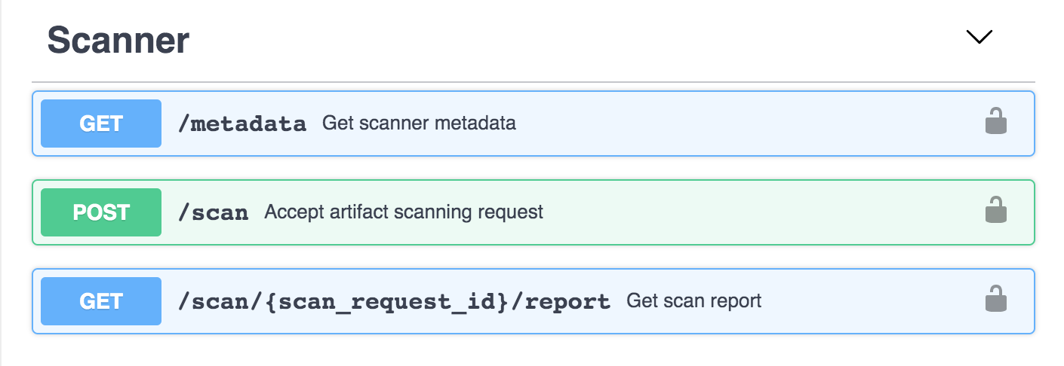
New scanner adapter
Just need to follow the Scanner Adapter v1.0 - OpenAPI Specification

Slide 5
Delivery in V1.10
Pluggable scanner framework – by Steven Zou@VMware/ShiJun Sun@VMware (UI)
aquasecurity/harbor-scanner-trivy – by Daniel Pacak@Aqua
goharbor/harbor-scanner-clair – by Daniel Pacak@Aqua
anchore/harbor-scanner-anchore – by Zach@anchore & HP team (Ye Liu & Maggie)

Slide 6
Please pay attentions
Early preview version, NOT the final version!
We’ll continue to do improvements later

Slide 7
Demo
https://10.192.247.34

